Slide 1

End of Semester Presentation
SEP Team 5

Slide 2

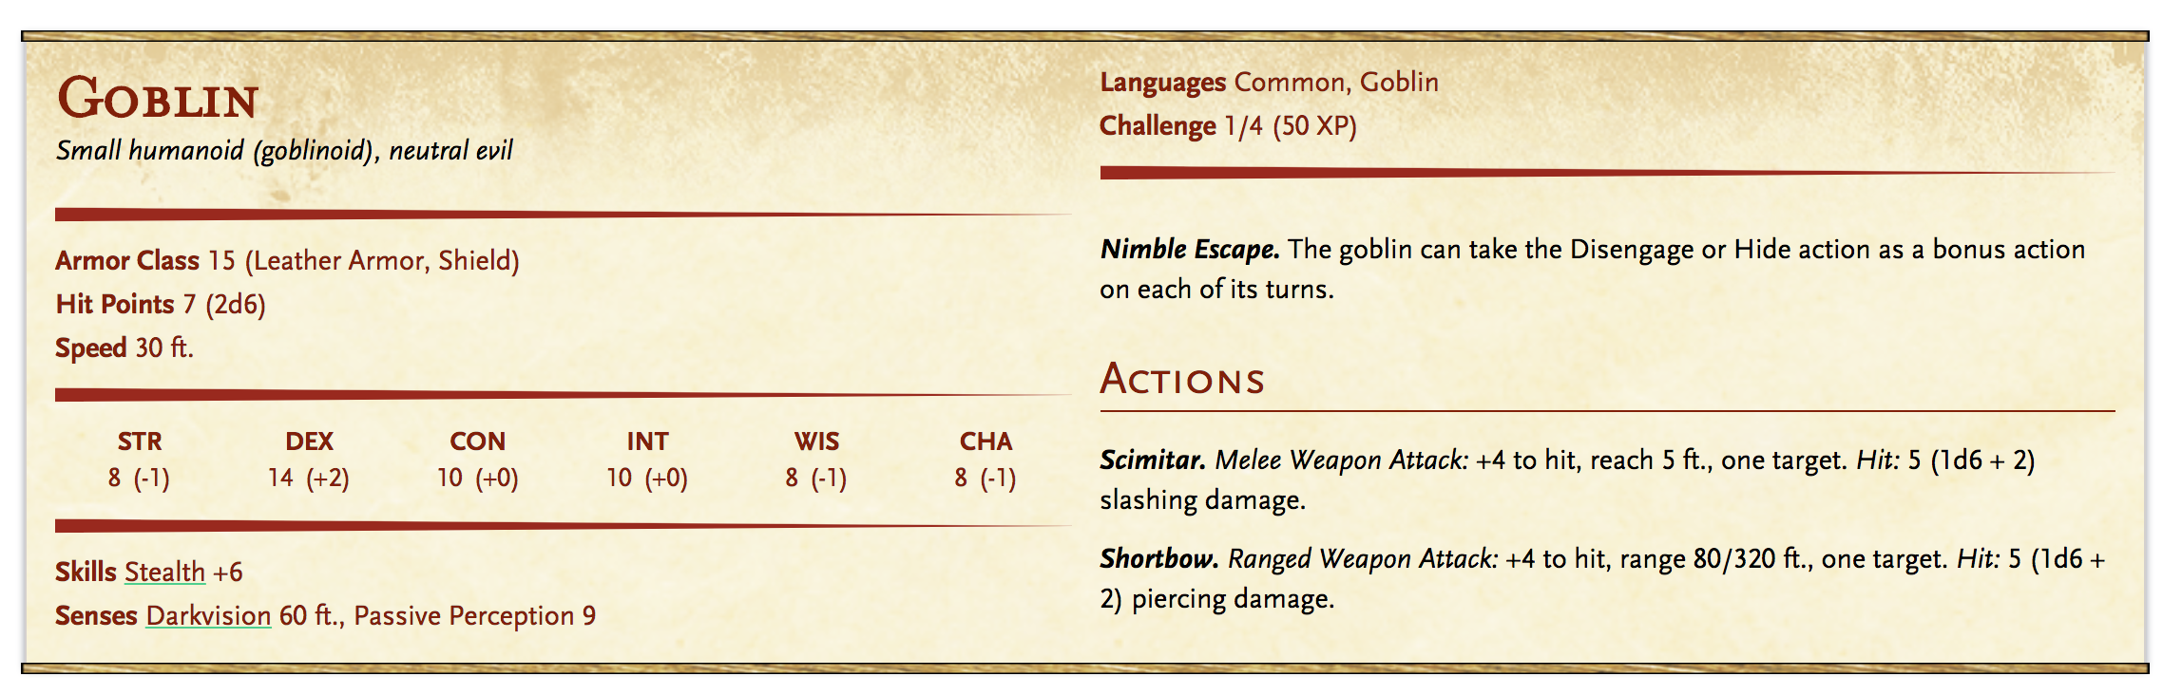
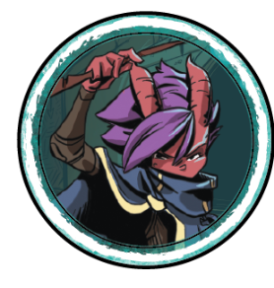
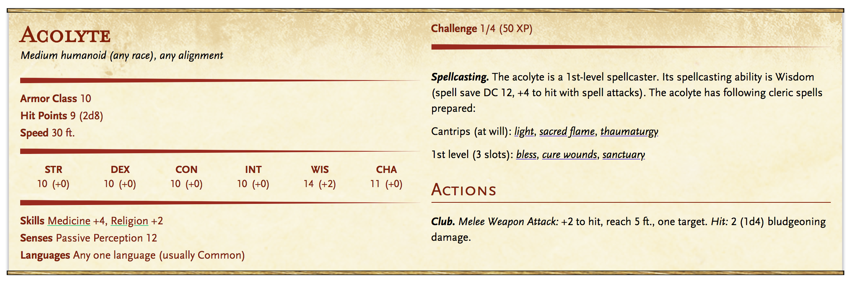
Product Overview (Review)
Things the narrator keeps track of:
Where are the characters?
How healthy are the characters?
What can/would each of the characters do?
How can each of the characters do this?
What does the character have with them and why?
And more...
Our Goal: Providing a centralized means of organizing and generating details for playing through encounters inside a campaign
Notes:
[Heather]
Same as project pitch so not adding notes

Slide 3
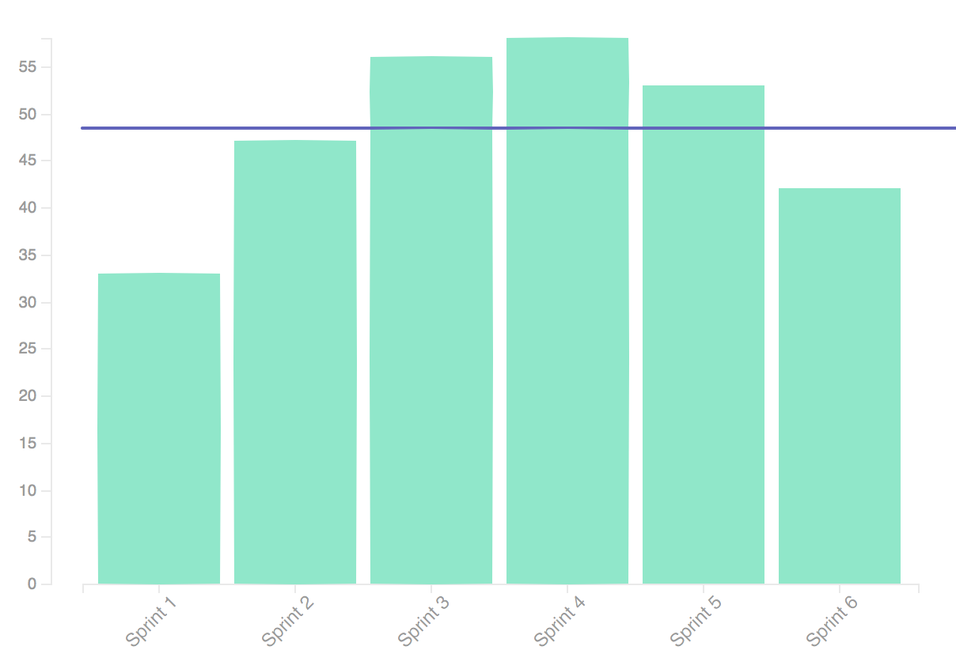
Semester In Review: Sprint Velocity
Average
Velocity
Completed:
222 Issues
298 Story Points
Notes:
222 Issues, 298 Story Points

Slide 4







Technology Platforms Used (Frontend)
Frontend Development
CSS / UI
Electron Store
React Dev Tools
Electron Webpack, Electron Store, React, React Dev Tools, and React Router
Bulma, Bloomer, and Material UI

Slide 5






Technology Platforms Used (Backend and Testing)
Backend Development
Fullstack Testing Suite
Node JS, TypeScript, Hapi JS, Joi JS, and Boom JS
TS-Enzyme, TS-Jest, and Nock
Notes:
Node JS with Hapi, Joi, and Boom

Slide 6







Technology Platforms Used (Server/Hosting/CI)
Database Development
Database/Server Hosting
Continuous Integration
Amazon Web Services, JSON Web Token (JWT), and Docker
PostgresQL and TypeORM
Travis CI and CodeCov

Slide 7
Process Strengths
PO was in our communication channels
Quick responses to questions/etc.
PR test running and code coverage requirements enforced by CI
Roadblocks were identified and removed in advance
(Following Sprint 2) Accurate and meaningful capacities and estimates
Modular components allowed for straightforward stack/feature changes

Slide 8
Process Weaknesses
Class and work loads are time intensive
Quick yet in-depth PR reviews are hard to keep up with
Full capacity was never available
Scheduling (regular) meetings is hard
Switching to text meetings instead of voices after a while lead to decreased communication within the group
For quick starting the project, we broke up into specialty areas, leading to lots of catch up time later

Slide 9
Lessons Learned
Agile’s strength are highlighted when the team can dedicate fully to it
Strong communication with PO/stakeholders is essential
Especially important before sprint closure
Well-rounded teams take more time to get setup but perform better overall
Team standards work best when ideals are shared rather than enforced
Product stack changes should be researched and communicated to the team in advance

Slide 10
Product Demonstration

Slide 11
Questions? Comments? Concerns?

